Slide 1
7-1 Lighting
5CM503 Virtual Environment Development
Dr Patrick Merritt

Slide 2
Contents
Lighting

Slide 3
Lighting
Light the way.

Slide 4
What is the purpose of lighting?
First and foremost, we need to see what we are doing.
But it also has additional functions beyond this.
The way a scene is lit can completely change its perception and communicate information to the player.

Slide 5
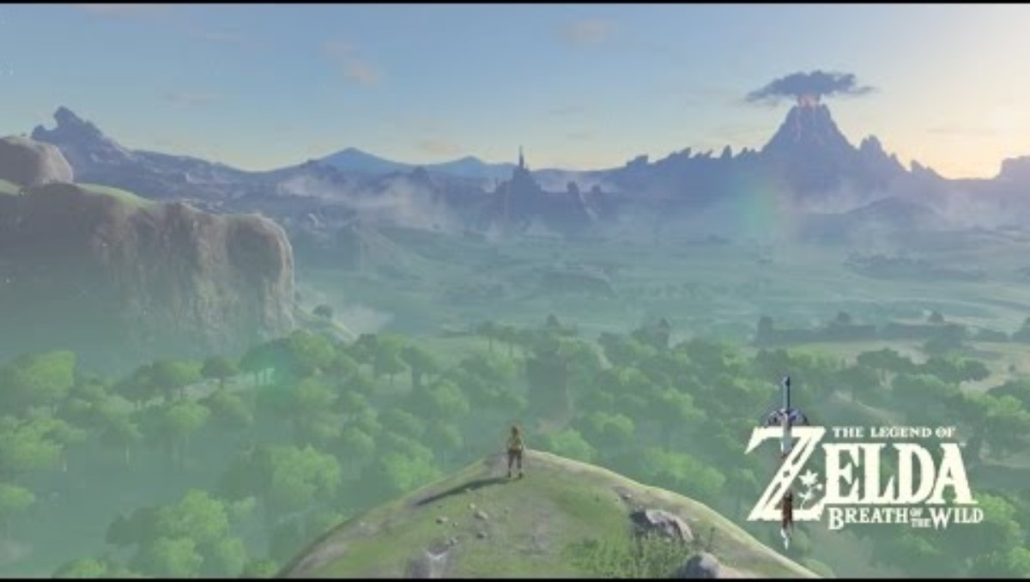

Slide 6
So, what do we need to do?
As programmers, we can set the general appearance of the lighting.
Artists can come and fine-tune after us.
We are not expected to be experts, but we must know how it works.
Particularly when we are using light to guide and inform our player.

Slide 7
Lumen
“Lumen is Unreal Engine 5's fully dynamic global illumination and reflections system that is designed for next-generation consoles, and it is the default global illumination and reflections system.”
This system will do a significant amount of the heavy lifting for us.
You will find that artists will mostly switch it off due to the performance overhead incurred by using it.

Slide 8
How does light work?
A game scene has one or more light sources.
Light sources emit light into the scene.
The engine calculates which surfaces of which models are illuminated by that light.
Surfaces that have illumination are bright. Those that do not are dark.

Slide 9

Direct illumination
A light source directly illuminates a surface that covers.

Slide 10
Global / Indirect illumination
Light bounces from the surface into the environment.
Intensity, direction and colour are influenced by the surface struck

Slide 11
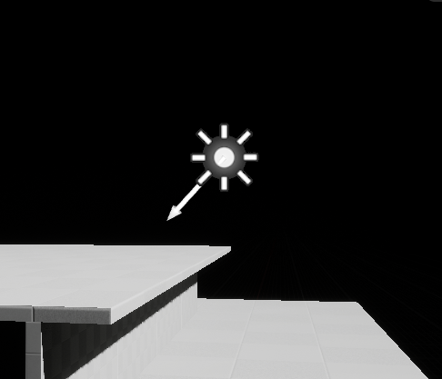
Directional light
A light source at an infinite distance applies uniform directional light to the scene.
A light that illuminates the whole level from a specific direction.

Slide 12
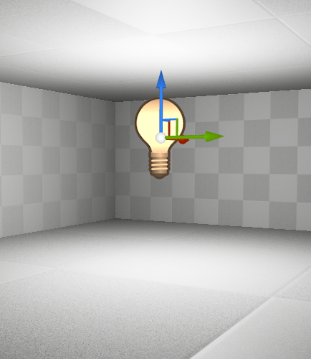
Point Light
Emits light equally in all directions.
Essentially a light bulb.

Slide 13
Point Light
Emits light equally in all directions.
Essentially a light bulb.
It’s actually 6 spotlights welded together but shhhh….

Slide 14
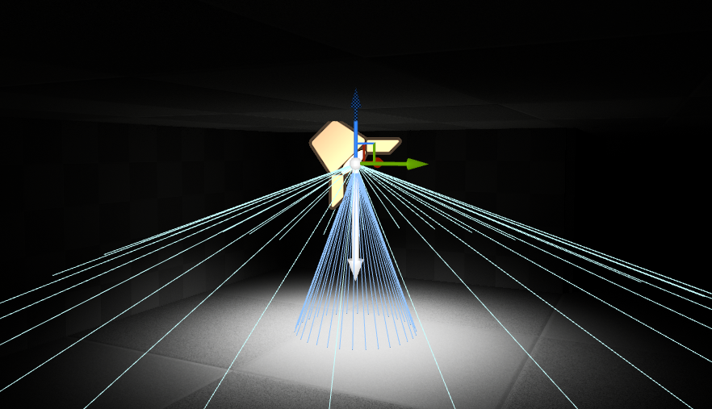
Spotlight
Emits light in a focused cone.
Like a spotlight in a theatre.
Actually made up of two cones
In the inner cone, everything inside is illuminated to maximum brightness for the light.
Falloff in the area between the outer and inner cones.

Slide 15
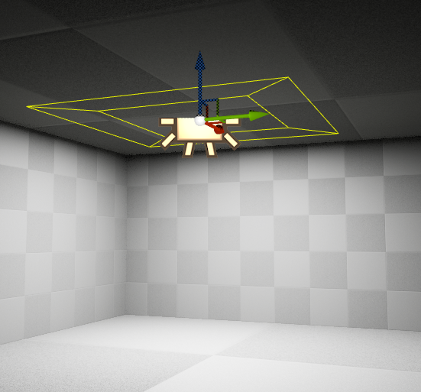
Rect Light
Emits light from a rectangular plane into a scene
Florescent lighting
Barn door angles narrow or widen the spread of the light

Slide 16
Light Mobility
Static lights are basically free (at runtime) but cannot be altered in anyway during runtime.
Quality is influenced the lightmap resolution.
Stationary lights provide the highest fidelity but are much more expensive than Static lights.
Max 4 overlapping
Can only change parameters such as intensity and colour.
Moveable lights can change most parameters (including rotation and position) giving the greatest flexibility.
But they are entirely calculated at runtime, incurring the greatest performance cost.
https://techarthub.com/lighting-companion-light-mobility-in-unreal-engine/#:~:text=Unlike%20lights%20with%20Static%20mobility,mask%2Fanimate%20the%20projected%20light.

Slide 17
Intensity
Brightness!
How bright a light is.
Does not change the range of the light.
Measured in Lumens.
1700 lumens = 100-watt lightbulb.
1 lumen = 1 candela (cd) = roughly the light of 1 candle

Slide 18
Attenuation Radius
Sets the reach of the light
Maximum reach of the light.
Falloff effects the rate of dimming towards the maximum extent.
Bigger lights get expensive quickly! Use large dynamic lights sparingly!
Not to be confused with source radius and length.
These change the size of the source of the light effecting specular highlights.

Slide 19
Light colour
Changes the colour of the light.
Additive pallet
Red + Green = Yellow.

Slide 20
Sky light
Apply lighting from distant parts of the level to illuminate the scene.
Light that comes from the sky.
Very complex to set up correctly, requires much fine tuning to get it right.

Slide 21
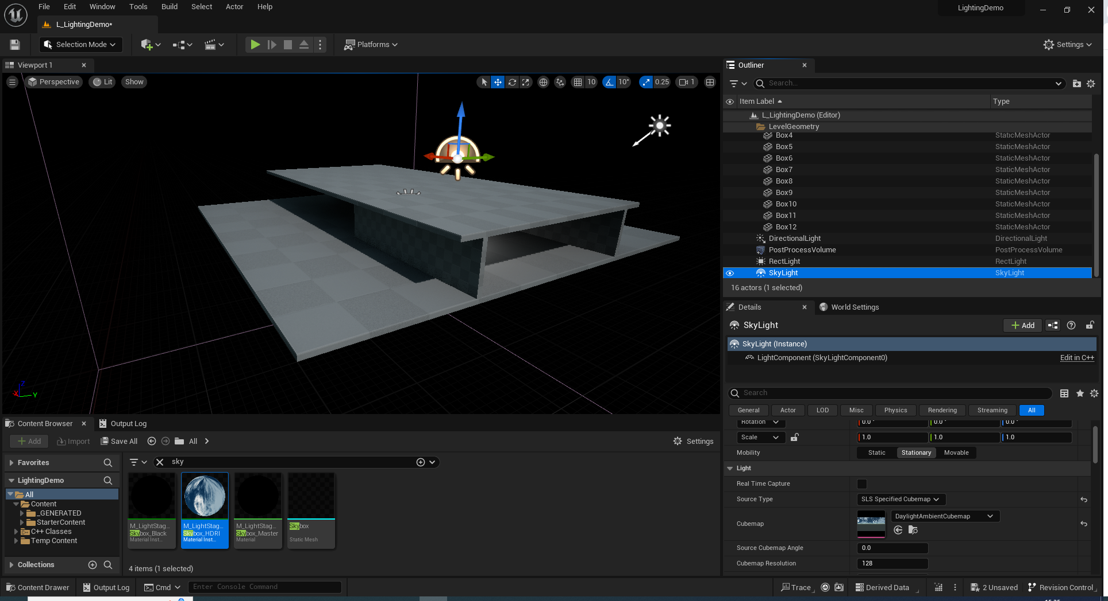
Static Setup

Slide 22
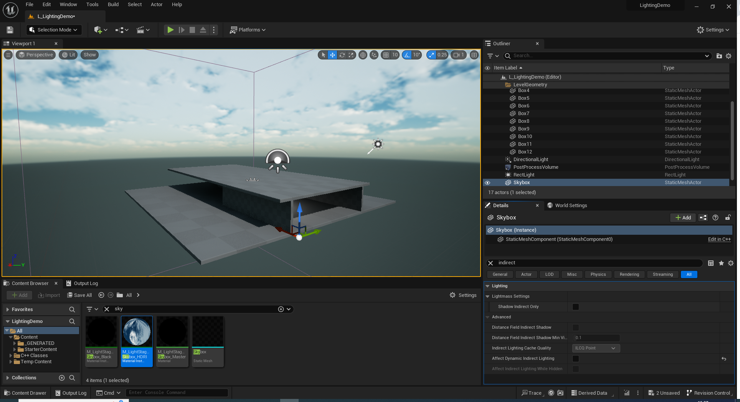
Static Setup:- Stopping the skybox from interfering!

Slide 23
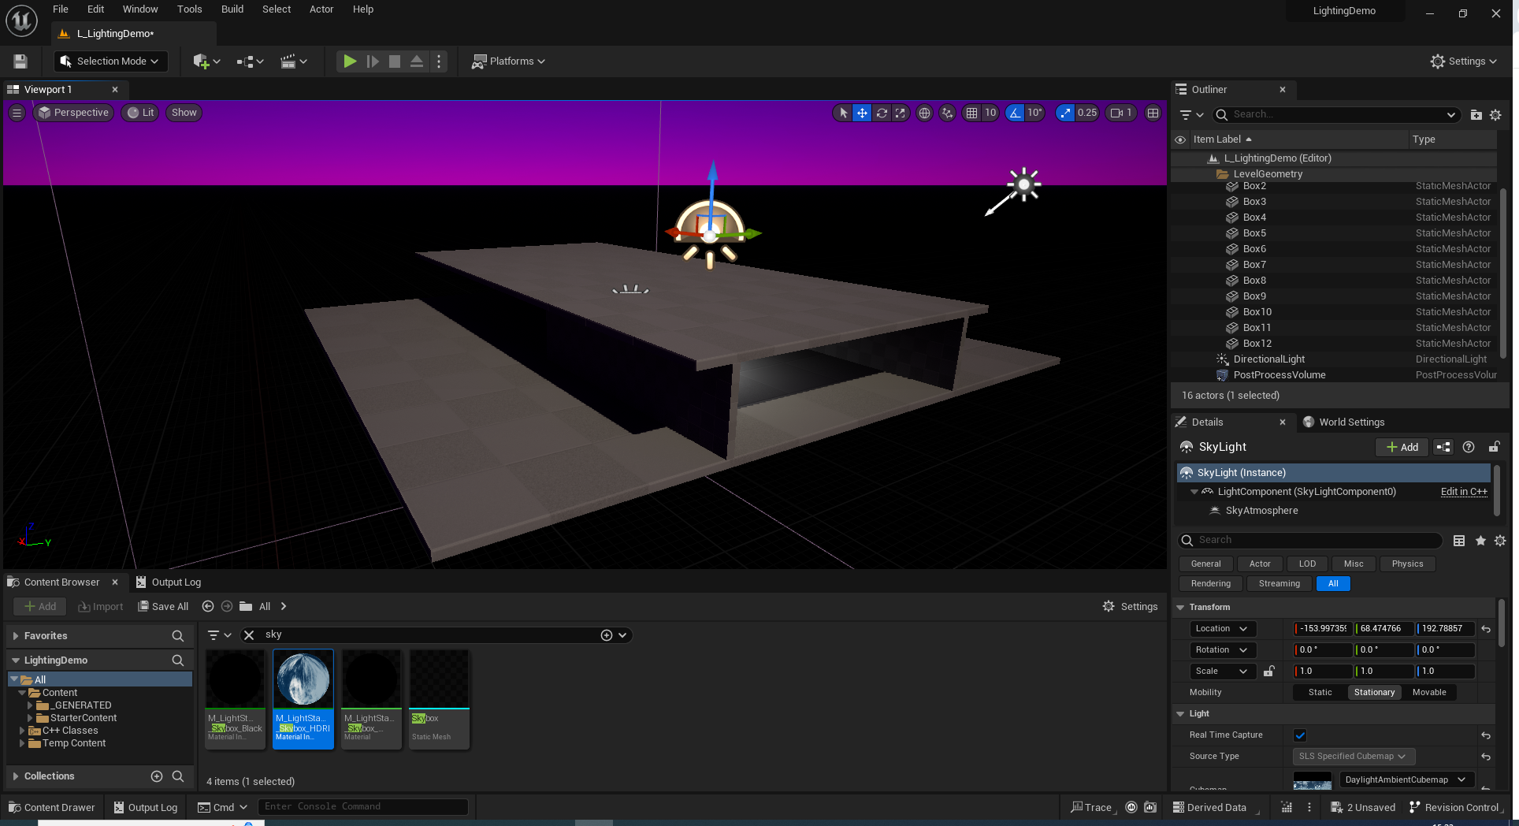
Real-Time Approach

